Slide 1
GAR
Session 06: Super Mario Bros
Notes:
Welcome. Today we build Super Mario Bros. The main topic: the game world.
Start by playing the finished game, Mario8, before any code.

Slide 2
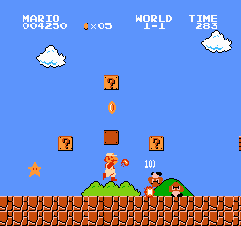
Super Mario Bros.
Super Mario Bros. (Nintendo, 1985). Screenshot © Nintendo.
Notes:
The original: Super Mario Bros. Ask who has played it, and what they remember of how it plays.
Today we build the parts that matter for the architecture.

Slide 3
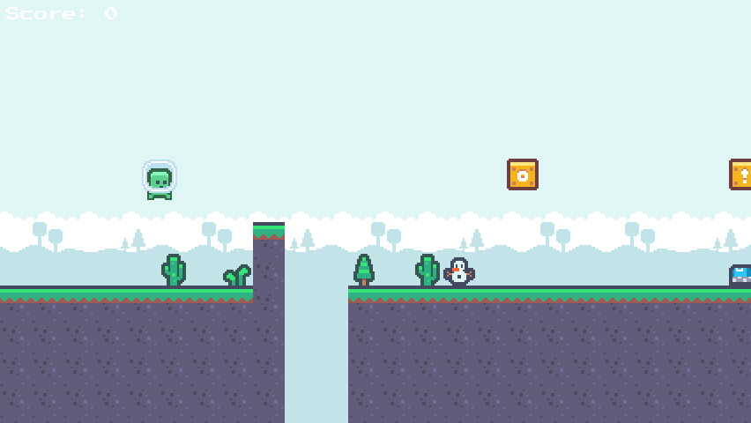
Today’s Goal
Notes:
Run Mario8 and play it for a minute.
Ask: what would you need to build this? Collect answers on the board, and come back to them at the end.

Slide 4
Today’s Topics
Main topic: The game world
Level Makers (Strategy, again)
Platformer Physics & Tile Collision
Debug Drawing
Player States (shared physics)
Camera
Basic AI
Notes:
Today’s main topic is the game world, which means a tilemap, entities and a camera. We also cover platformer physics and tile collision, level makers (Strategy), player states and debug drawing.

Slide 5
Source Code
github.com/Metamate/gar-games, folder 06-super-mario-bros
Its README: the steps (Mario0 to Mario8), where things are in the code, how to run it
The course site: today’s concepts in full, the exercises, and questions to check yourself
Notes:
Open gar-games/06-super-mario-bros live. Show the README: the step table, the code map, how to run a step.
Say: the site explains the ideas, the README helps you find them in the code, the slides are for today.

Slide 6
Level Generation
<Tilemap>
<Tileset region="0 16 24 24" tileWidth="8" tileHeight="8">images/atlas</Tileset>
<Tiles>
00 01 01 01 02
03 04 04 04 05
03 04 04 04 05
03 04 04 04 05
06 07 07 07 08
</Tiles>
</Tilemap>
00 01 01 01 02
03 04 04 04 05
03 04 04 04 05
03 04 04 04 05
06 07 07 07 08
Notes:
Snake’s room came from a file of tile numbers. A platformer’s levels will come from code instead.

Slide 7
Procedural Level Generation
public Tilemap Generate(int columns, int rows)
{
tilemap = new(Tileset, columns, rows);
int groundHeight = 2;
for (int x = 0; x < columns; x++)
{
for (int y = 0; y < Tilemap.Rows; y++)
{
if (y >= Tilemap.Rows - groundHeight)
{
Tilemap.SetTile(x, y, 1);
}
}
}
return tilemap;
}
00 00 00 00 00
00 00 00 00 00
00 00 00 00 00
01 01 01 01 01
01 01 01 01 01
Notes:
The simplest level maker: fill the bottom two rows with ground. Everything else builds on this loop.

Slide 8
Tilemap Update
A tile now knows more than its picture.
Snake: an int
which picture to draw
Platformer: a Tile
GraphicId · IsSolid
Collision asks the tilemap: is there something solid at (x, y)?
The grass toppers are a second tilemap, drawn on top.
Notes:
Snake’s tile was an int: which picture. Now a tile also knows whether it’s solid, so collision can ask the tilemap.

Slide 9
Tile
public readonly struct Tile(int graphicId = -1, bool isSolid = false)
{
public static readonly Tile Empty = new();
public int GraphicId { get; init; } = graphicId;
public bool IsSolid { get; init; } = isSolid;
public bool IsEmpty => GraphicId < 0;
}
Notes:
The Tile struct: a graphic ID and IsSolid. Empty means no graphic.

Slide 10
Try It: A Level in Code
In Mario0’s GenerateLevel:
Leave a gap two tiles wide in the ground
Raise the ground by two tiles in the middle
Press R: what changes, and what doesn’t?
Notes:
Pairs, about 5 minutes, in Mario0. GenerateLevel fills the bottom rows with solid tiles.
A gap: skip two columns in the loop. Higher ground: a larger GroundHeight for some columns.
Ask about R. Answer: only the graphics change; the shape is code, so the gap stays.

Slide 11
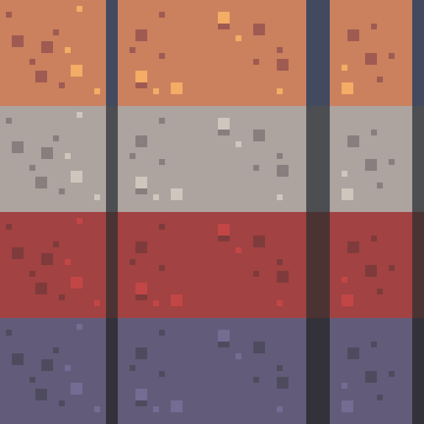
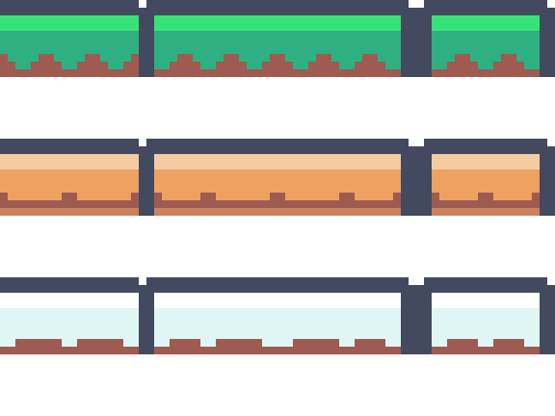
Tilesets
Notes:
Four tilesets and three topper sets, each in one image, a row per set. R in the game picks a random combination.

Slide 12
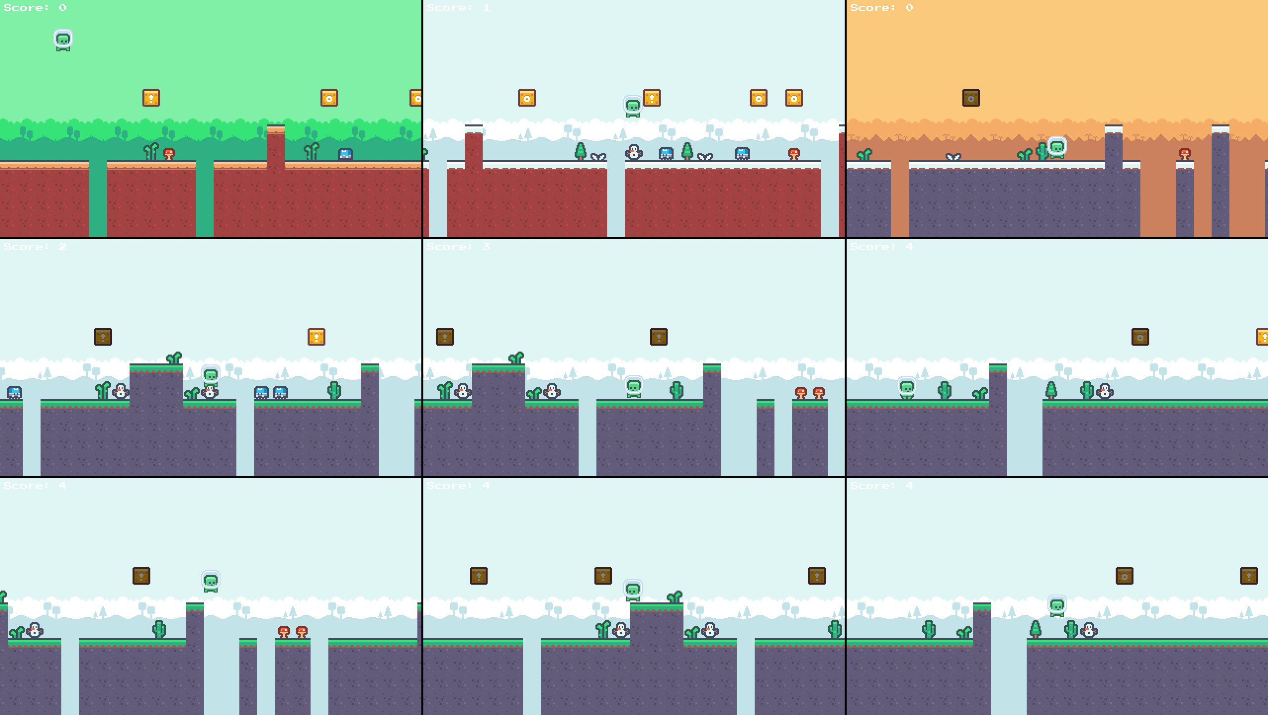
GameLevel
Notes:
Nine random levels from the same code. Same rules, different looks.

Slide 13
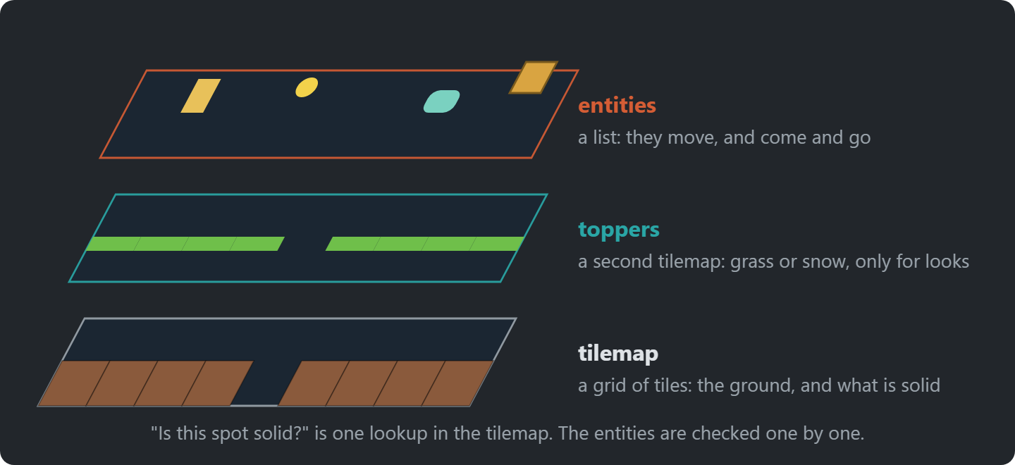
A Level in Layers
Notes:
A level is two tilemaps and a list of entities. The tilemap holds what is solid; the toppers are only for looks; the entities move.
Ask: why are the toppers not part of Tile? Answer: they are a detail of this game, and Tile is in GARCore.

Slide 14
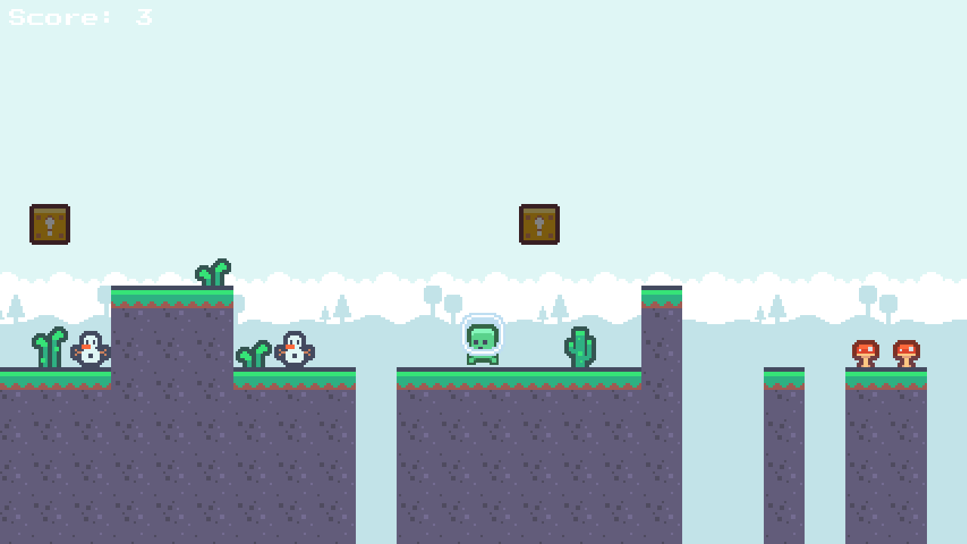
LevelMaker
LevelMakerBase
SimpleLevelMaker
FlatLevelMaker
PillarLevelMaker
PitLevelMaker
ComplexLevelMaker
(This is the Strategy pattern)
Notes:
A family of level makers behind one base class; the game picks one. That’s the Strategy pattern, as in Pac-Man’s targeting.

Slide 15
LevelMaker Implementation
DEMO!
Mario0 → Mario1: tilemaps from code and level makers
Notes:
Demo: open Mario0 and Mario1 side by side (a diff tool, or two editor panes), then run Mario1.
- LevelMakerBase and the five makers
- keys 1 to 5 switch the maker in Mario1

Slide 16
Try It: A Level Maker
In Mario1’s PitLevelMaker:
Make pits twice as common
Press 4 to see it, and R for new graphics
Notes:
Pairs, about 5 minutes. pitChance in PitLevelMaker. Only that maker changes; the game still just asks a maker for a level.

Slide 17

Input
We now have a GameController class that abstracts away hardcoded keys for “actions”
Is this the Command pattern from Sokoban?
  Why not?
Notes:
GameController maps keys to actions, as in Snake. Ask: is this the Command pattern? No: nothing is turned into an object you can store or undo.

Slide 18
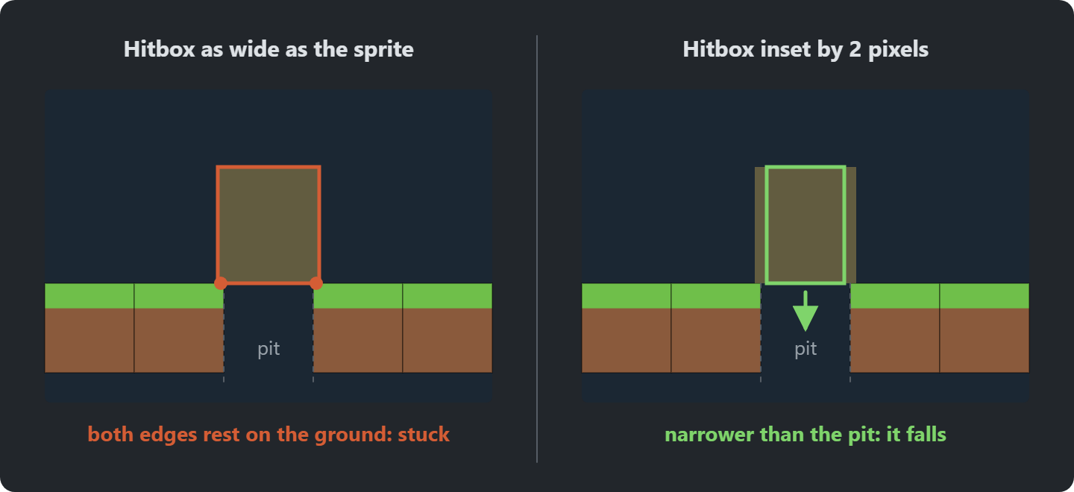
Player Hitbox
The player is a little wider than a tile
Notes:
The player is a little wider than a tile, so it can run across a one-tile pit. Shrink the hitbox by 2 pixels each side, and it falls.
So it runs across a one-tile pit without falling in
We shrink the hitbox by 2 pixels on each side
Now the pits have to be jumped

Slide 19
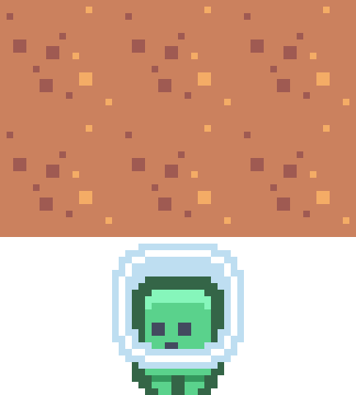
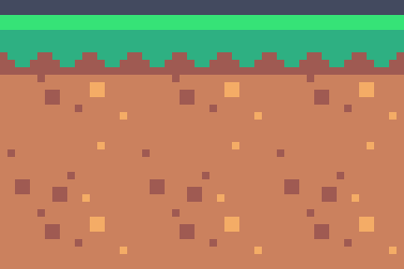
Tile Collision (up/down)
Notes:
Two points per direction, at the hitbox’s corners (the red dots), slightly inset. Ask: why inset? So you can jump up next to a wall without catching it.

Slide 20
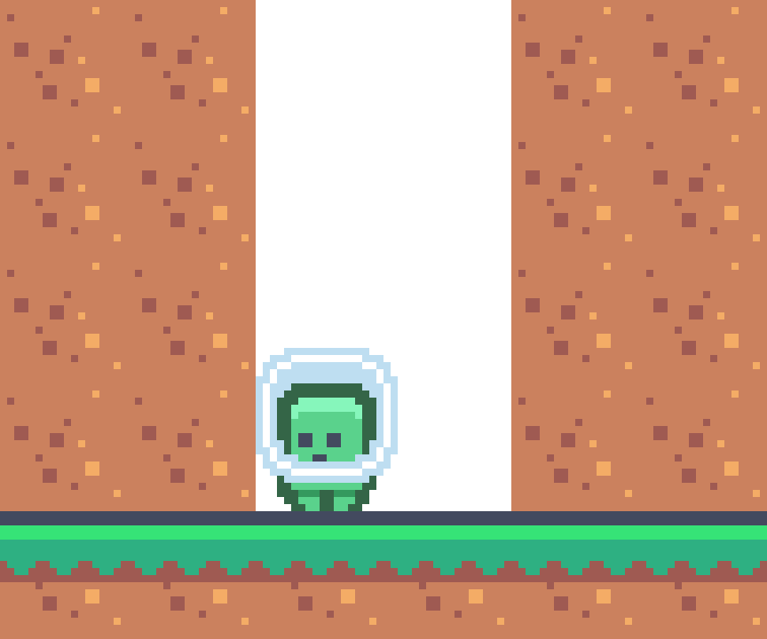
Tile Collision (left/right)
Notes:
The same for walls: two points on each side, inset so you don’t catch the floor or a tile just above.

Slide 21
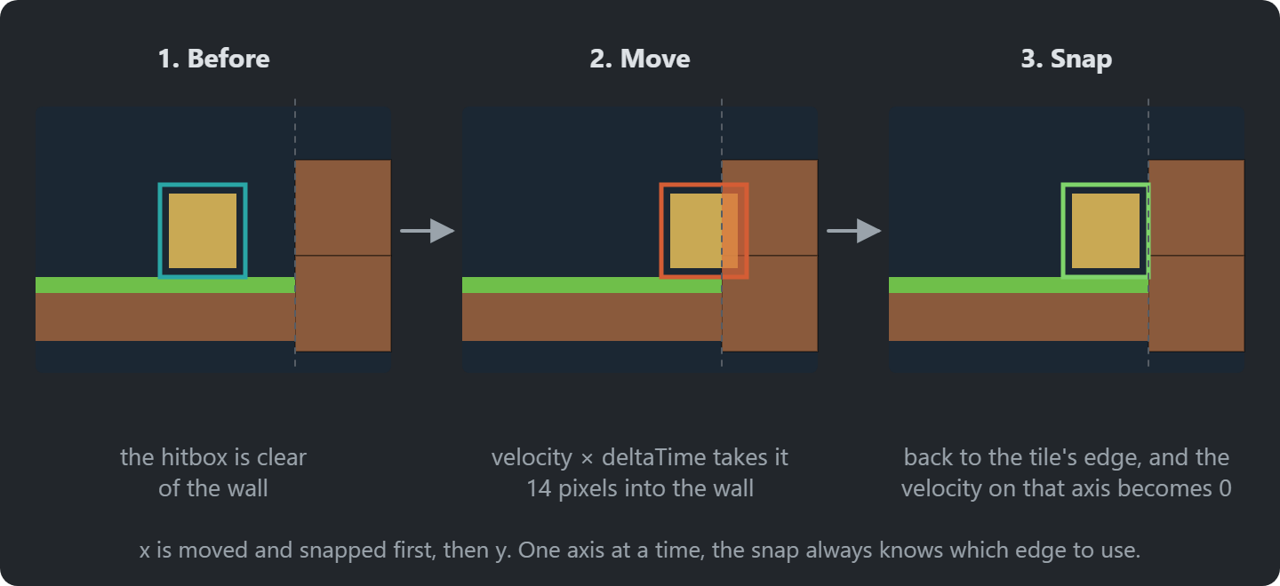
Move, Then Snap
Notes:
The player moves first and is corrected afterwards: back to the edge of the tile it overlaps, with the velocity on that axis set to zero.
x first, then y. One axis at a time, the snap always knows which edge to use.

Slide 22
Collision Response
private void SnapToRight(float x)
{
Player.Position = new Vector2(x - Player.Sprite.Width + Player.HitboxInset, Player.Position.Y);
Player.Velocity = new Vector2(0, Player.Velocity.Y);
}
private void SnapToLeft(float x)
{
Player.Position = new Vector2(x - Player.HitboxInset, Player.Position.Y);
Player.Velocity = new Vector2(0, Player.Velocity.Y);
}
private void SnapToBottom(float y)
{
Player.Position = new Vector2(Player.Position.X, y - Player.Sprite.Height);
Player.Velocity = new Vector2(Player.Velocity.X, 0);
}
private void SnapToTop(float y)
{
Player.Position = new Vector2(Player.Position.X, y);
Player.Velocity = new Vector2(Player.Velocity.X, 0);
}
Notes:
Snap to the tile edge and zero the velocity in that direction. The inset appears again here.

Slide 23
Try It: One Collision, by Hand
On paper, 18-pixel tiles:
The hitbox spans x 34 to 50, and moves 8 pixels right
A wall starts at x 54
Where is it after the move, and after the snap? What happens to its velocity?
Notes:
Pairs, about 3 minutes, on paper.
Answer: after the move the hitbox spans 42 to 58, 4 pixels into the wall. It snaps back so its right edge is at 54 (left edge 38), and the horizontal velocity becomes 0. Then the same for y, separately.

Slide 24
IsOnGround
protected bool IsOnGround()
{
Rectangle hitbox = Player.Bounds;
// Check Tilemap
bool onTile = Player.Tilemap.IsSolidAt(hitbox.Left + CollisionInset, hitbox.Bottom + 1) ||
Player.Tilemap.IsSolidAt(hitbox.Right - CollisionInset, hitbox.Bottom + 1);
if (onTile) return true;
// Check solid Entities
Rectangle sensor = ExpandDirectional(hitbox, 0, 1);
return Player.Level.Entities.Any(e => e.Active && e.IsSolid && e.Collidable && sensor.Intersects(e.Bounds));
}
Notes:
On the ground if a solid tile or a solid entity is just below the hitbox. The jump state asks this.

Slide 25
Tilemap Additions
public Vector2 TileToPoint(int column, int row)
public bool IsSolidAt(float x, float y)
public float GetTileLeft(float x)
public float GetTileRight(float x)
public float GetTileTop(float y)
public float GetTileBottom(float y)
private Tile? GetTileAt(float x, float y)
Notes:
The helpers that make the rest short: tile to point, is solid at, tile edges.

Slide 26
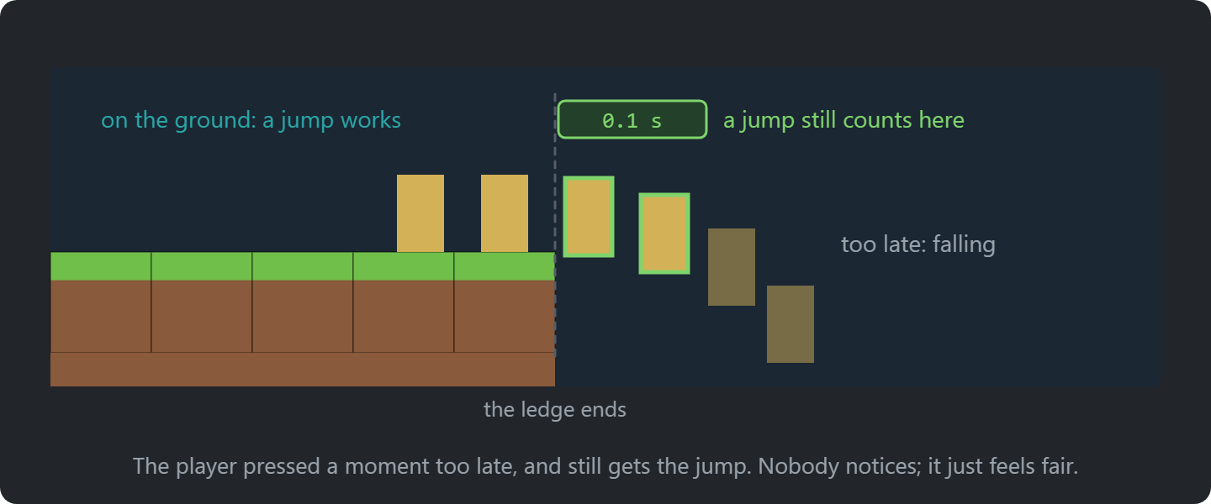
Coyote Time
Notes:
Let the player jump for a few frames after leaving a ledge, like the coyote running off the cliff. Feels fair; players never notice.

Slide 27
Platformer Physics Performance
The player against the tiles: a lookup. Against entities: checks.
Tiles: O(1)
the grid never moves: look up
the tile at a point
Entities: O(n) per mover
they move, so check each;
every pair would be O(n²)
public bool IsSolidAt(float x, float y) => GetTileAt(x, y)?.IsSolid ?? false;
Notes:
The tiles never move, so checking a point is a lookup: O(1), however big the level.
Entities move, so each needs a check; every pair would be O(n²). Vampire Survivors deals with that.

Slide 28
Debug Drawing
The player falls through a corner, and you can’t see why, because hitboxes are invisible.
Solid tiles
drawn in red
The player’s hitbox
drawn in green
Entities
drawn in yellow
Press F1. DebugDraw in GARCore draws nothing unless enabled, so the calls can stay in the code.
The debugger
exact values, at one moment
Debug drawing
what happens, over time
Notes:
Ask the question: the player falls through a corner; why? You can’t tell: the hitbox isn’t drawn.
F1 draws what the game can’t show. The debugger shows one moment; debug drawing shows motion over time.

Slide 29
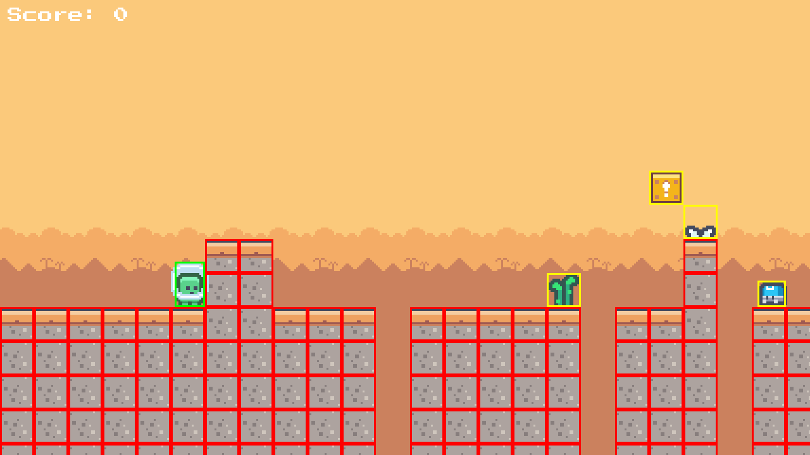
Debug Drawing in Action
Notes:
Red: solid tiles. Green: the player’s hitbox. Yellow: entities.

Slide 30
Platformer Physics Implementation
DEMO!
Mario2: gravity, tile collision, coyote time and debug drawing (F1)
Notes:
Demo: run Mario2 and press F1. Jump into a corner, walk off a ledge and jump late (coyote time), and watch the hitbox.

Slide 31
Try It: Hitbox and Coyote Time
In Mario2, press F1:
Set HitboxInset to 0. Can you still fall into a one-tile pit?
Set CoyoteTime to 0.5. How does jumping off ledges feel?
Notes:
Pairs, about 5 minutes. Both constants are in Player. Without the inset, the player is as wide as a tile and walks over one-tile pits. Half a second of coyote time feels like jumping in mid-air.

Slide 32
Player States
Mario2: an enum and switches, where Pac-Man’s ghosts started
Mario3: one class per state, as in Pac-Man
New: shared physics, once, in PlayerStateBase
New: the level triggers transitions (no ground, top of the jump, landing)
Notes:
Pac-Man already taught the State pattern; this is what the player adds.
Shared physics: gravity, tile collision and moving sideways live once in PlayerStateBase; the duck state only overrides the sideways movement.
Transitions from the level: IsOnGround, velocity at the top of the jump, landing. Ask: which transitions in the diagram come from input, and which from the world?

Slide 33
Player State Implementation
DEMO!
Mario2 → Mario3: from an enum to the State pattern
Notes:
Demo: open Mario2 and Mario3 side by side (a diff tool, or two editor panes), then run Mario3.
- PlayerStates/: idle, walk, jump, fall, duck
- each state decides its own transitions

Slide 34
Try It: Tune the Player
In Mario3:
Make the player jump higher, and walk faster
Which class holds each value?
A double jump: a new state, or a flag?
Notes:
Pairs, about 5 minutes. JumpImpulse in PlayerJumpState, MoveSpeed in PlayerStateBase.
For the double jump, take a few answers: a count in the jump and fall states is enough; a flag on Player is what the State pattern tries to avoid.

Slide 35
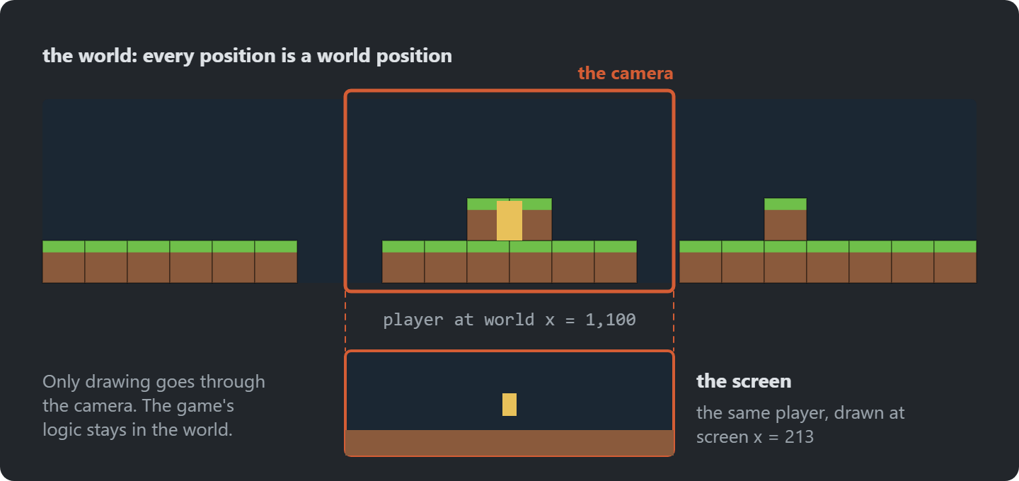
Camera
The level is wider than the screen. Something has to follow the player.
Notes:
Ask the question at the bottom first: why didn’t earlier games need a camera? Their world fit on one screen.
The camera shifts the whole world by one matrix, and stops at the level’s ends. Only x here.
centred on the player
The camera shifts the whole world by one matrix, and stops at the ends of the level.
Only on x, since the level is one screen tall.
Why didn’t Pong, Snake or Pac-Man need a camera?

Slide 36
Camera Implementation
DEMO!
Mario4: camera and a wide level
Notes:
Demo: open Mario3 and Mario4 side by side (a diff tool, or two editor panes), then run Mario4.
- Graphics/Camera.cs
- the transform passed to SpriteBatch.Begin
- walk to the end of the level: the camera stops
- then run Mario5: a title state and a play state, as in Flappy Bird; no need to open the code

Slide 37
Try It: The Background
In Mario4’s GameLevel:
Make the background scroll at a quarter of the camera’s speed
What do 0 and 1 look like?
Notes:
Pairs, about 5 minutes. parallaxFactor in DrawBackground. 0: the background never moves, like a painted sky. 1: it moves with the level, and the depth is gone.

Slide 38

Entities
Entities are the things that aren’t tiles. They move, and don’t line up with the grid.
The player, slimes, boxes, coins; each with its own states.
Many kinds of entity, each a class. Where does that end?
Notes:
Entities: anything that isn’t a tile. They move and don’t line up with the grid.
Ask the question: a class for every kind of entity; where does that end? Zelda and Plants vs. Zombies answer it.

Slide 39
Entity
public interface IEntity
{
public Vector2 Position { get; set; }
public Rectangle Bounds { get; }
public bool Collidable { get; set; }
public bool IsSolid { get; }
public bool Active { get; set; }
void Update(GameTime gameTime);
void Draw(SpriteBatch spriteBatch);
bool Collides(IEntity other);
}
The level updates and draws every entity in one loop
  The Update Method pattern, from Pong
Entities collide with each other
  Each entity decides how to handle collisions
  They move, so there is no grid to look them up in: each one is checked
Notes:
IEntity: what every entity has. The level updates and draws them all in one loop: the Update Method pattern from Pong.

Slide 40

Slime States (Aka Basic AI)
The slime’s AI is a state machine too.
Idle
waits a while
Walk
turns at edges
player near
Chase
towards the player
SlimeStateBase: gravity, ground, collisions, shared by all three
The player’s base state does the same collision work. How could they share it?
Notes:
The slime’s AI is the same pattern: idle, walk, and chase when the player comes close.
Ask the question: the player and the slime do the same collision work. How could they share it? A base state, or something both use.

Slide 41
Slime State Implementation
DEMO!
Mario7: slime AI
Notes:
Demo: open Mario6 and Mario7 side by side (a diff tool, or two editor panes), then run Mario7.
- SlimeStates/
- AnimatedSprite.Play swaps animations
- the collision code duplicated between slime and player: Zelda picks this up

Slide 42
Chunks and Moving Platforms
Start from Mario8. Full instructions are on the course site.
Design a few short chunks by hand, as small tile grids in a data file
A level maker that strings random chunks together, longer every level
A moving platform that carries the player standing on it
Where does “carried along” belong?
Notes:
Exercise: a level maker built from hand-made chunks, and a moving platform.
The chunks mix both earlier approaches: designed by hand, combined by code. Spelunky works this way.
Ask about the platform. Answer: there is no single right place; a common one is the player remembering what it stands on, and moving with it.
Full instructions are on the course site; students work from there. Walk round while they work.

Slide 43

Add Powerups to the Game
A power-up is an entity that changes the player
  A diamond: invincible for a few seconds
  A mushroom: the player grows
The art is in the repo: Content/Assets/images/extras.png (the game doesn’t use it yet)
Notes:
A power-up is an entity that changes the player. The obvious way is a flag and a timer on Player for each one. Ask: what does Player look like after five power-ups? The exercise asks for a way without piling flags onto it.
The art for the power-ups is in the repo, in extras.png. The game doesn’t use it yet.

Slide 44
Exercise: Debug Drawing
Also draw the probe below the player that checks for ground
IsOnGround, in PlayerStateBase
Show the player’s state and velocity on screen
Use it to find where coyote time starts and ends
Notes:
Exercise: extend the debug drawing. The probe is IsOnGround in PlayerStateBase.
Ask afterwards: how long does coyote time last on screen? About six frames (0.1 s).
Full instructions are on the course site; students work from there. Walk round while they work.

Slide 45
Check Yourself
What do the player’s states share, and where does that code live?
Why can tile collision be O(1) while entity collision can’t?
Why keep debug drawing in the code, behind a switch, instead of deleting it?
The answers, and more questions, are on the course site.
Notes:
Ask one question at a time. Pairs discuss for a minute, then take two or three answers.
Expected answers (from the course site):
Q: What do the player’s states share, and where does that code live?
A: Every state needs gravity, tile collision and moving sideways, so they live once in PlayerStateBase. Each state overrides only what is different about it. Without the base class, every state would carry its own copy of the physics, and a fix to one would miss the others.
Q: Why can tile collision be O(1) while entity collision can't?
A: Tiles never move and sit in a grid, so a position maps directly to a tile index. Entities move freely, so we have to check them against each other.
Q: Why keep debug drawing in the code, behind a switch, instead of deleting it once a bug is fixed?
A: The next bug needs it too. Behind a switch it costs nothing when it is off, and anyone working on the game can turn it on to see what the collision code is doing.

Slide 46
Apply It to Your Project
What would you want to see while debugging your game?
  Add debug drawing for hitboxes, triggers or AI targets, behind a key
Which entities have distinct behaviour modes? Draw a state diagram for one
Is anything a set of booleans that should be a state machine?
Notes:
Give the project groups five minutes with these questions.
Ask two groups to share one answer each, and push them to name actual classes and files.

